Slide 1
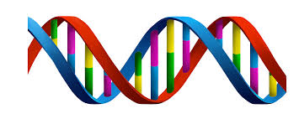
DNA, Chromosomes and Genes

Slide 2
Learning Intentions
Distinguish between DNA, a chromosome and a gene.
Describe the structural characteristics of a DNA molecule eg sugar, phosphate and 4 bases.
Define gene and genome.

Slide 3
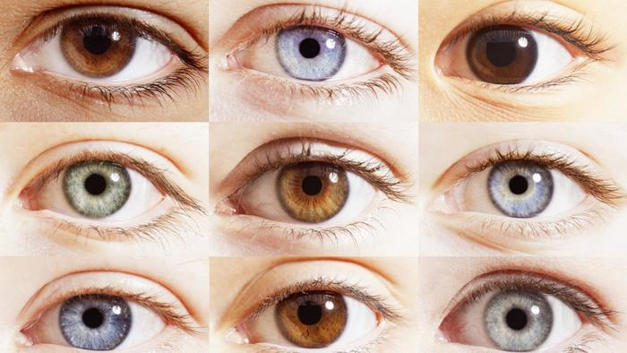
Genetics
Genetics is the scientific study of genes and inheritance in living things (organisms).

Slide 4
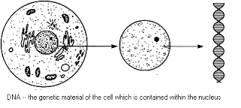
DNA
DNA is a molecule that is found in the nucleus of every living cell.
A small amount of DNA is also found in the mitochondria as well.
Deoxyribonucleic acid

Slide 5
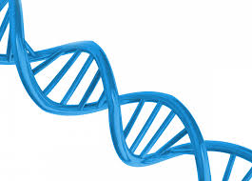
DNA
Molecules of DNA are in the form of long strands.
It is estimated that the length of a DNA molecule in a human cell is 2-3 metres long – so how do such long molecules fit inside the cell nucleus?

Slide 6
DNA
A strand of DNA is called double helix
Double: 2
Helix: single wound structure

Slide 7
Clip – DNA movie3

Slide 8
Genes
Sections of the DNA molecule in a chromosome make up a gene.
A gene forms the genetic code, which is stored information that determines the structure and activities of the cell.

Slide 9
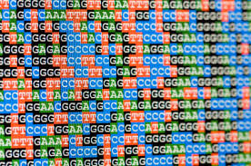
Genome
The genome is the complete set of genetic information of an organism.

Slide 10
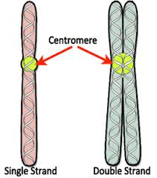
Chromosomes
A long strand of DNA, coiled up around histones, is called a chromosome.

Slide 11
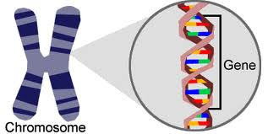
Genes

Slide 12
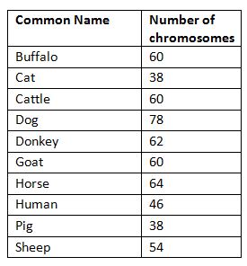
Cells each contain 46 chromosomes.
Exceptions are the sperm and egg cells, which only contain 23 chromosomes and red blood cells, which have no nucleus (meaning NO DNA)
Other organisms have different numbers of chromosome pairs in their cells.

Slide 13
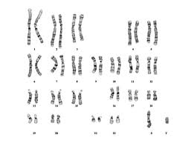
Male Karyotype

Slide 14
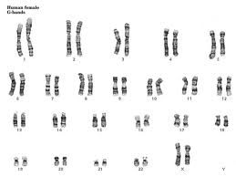
Female Karyotype

Slide 15
Karyotype
A karyotype is the number and appearance of chromosomes in the nucleus.

Slide 16
Receiving Genes …
You receive one set of genes from your mum and one from your dad. So one of each of you chromosomes are from each parent.
The male sex chromosomes are: XY
The female sex chromosomes are: XX

